Slide 1
1980s cars
Dataset Analysis

Slide 2
Layout
Problem
Results
Analysis of the Results

Slide 3
Problem

Slide 4
Problem
We shall analyze a dataset with cars from 1985 and collect some insights from it, in particular regarding their price.
Each car model is described by 26 features, for example the miles per gallon driven in the city, and its number of doors.
We will explore the relations between the features, and define groups based on them.
Finally, we build predictive models to estimate the price of the car.

Slide 5
Results

Slide 6
Results
The prices of the cars accumulate in towards lower values, as would be expected, in order to serve the mass market.
Examples of other characteristics observed in the mass market cars is that almost all of them run on gas, the engine is located in the front, and their engines have either 4 or 6 cylinders.
We also observe that many features are highly correlated. As a few examples, we can mention the miles per gallon driven in the city and driven in the highway, or the width, length, wheel-base and curb-weight of the car.
Finally, we build a predictive model that predict the price of the cars with an average error of 2000 USD.

Slide 7
Analysis of the Results

Slide 8
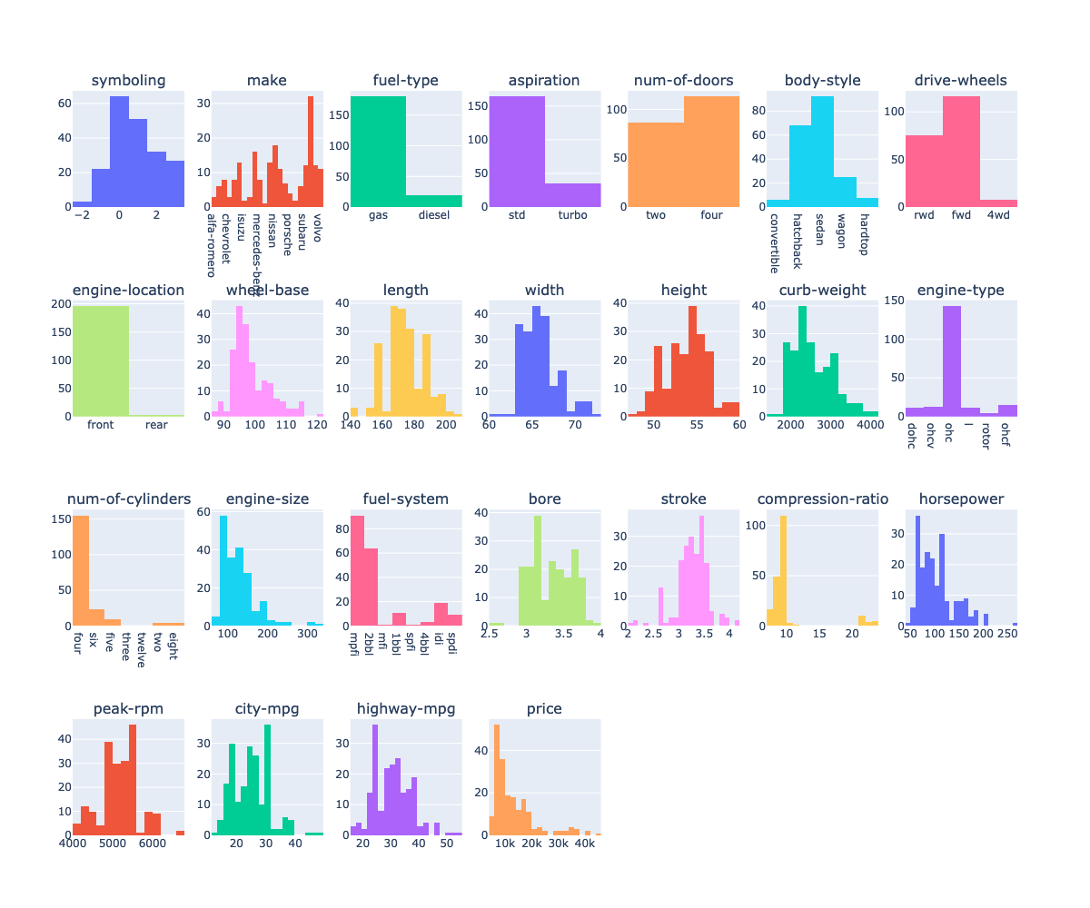
Analysis of the Results
We start by looking at the distribution of the features.
We can find common patterns displaying some similarities in mass market cars.

Slide 9
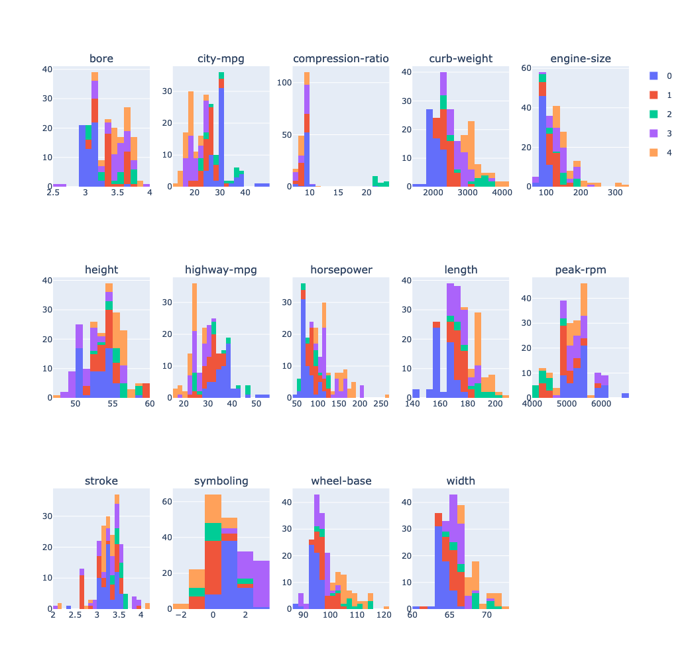
Analysis - Numerical Features
Employing clustering algorithms, we find more relations between features, for example, cars with lower horsepower are also smaller, having lower width and length.

Slide 10
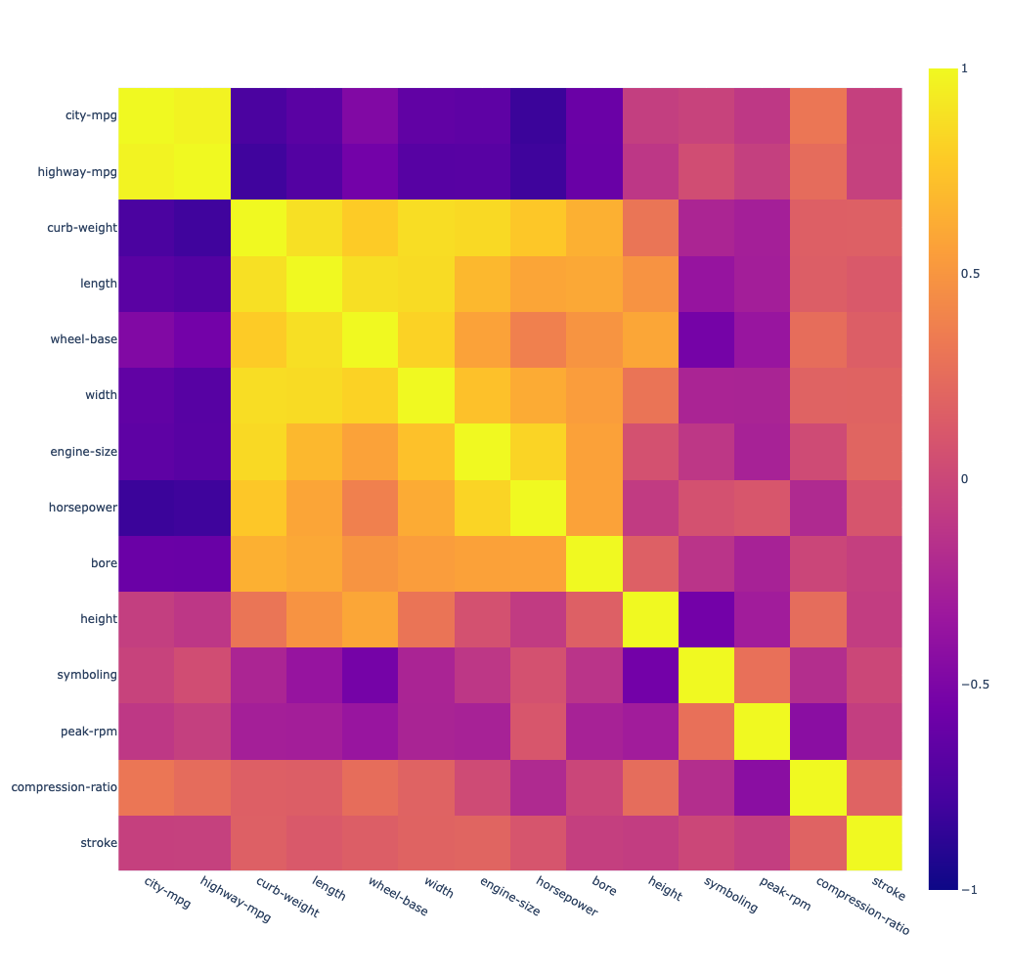
Analysis - Numerical Features
The previous relations can also be verified using correlation.

Slide 11
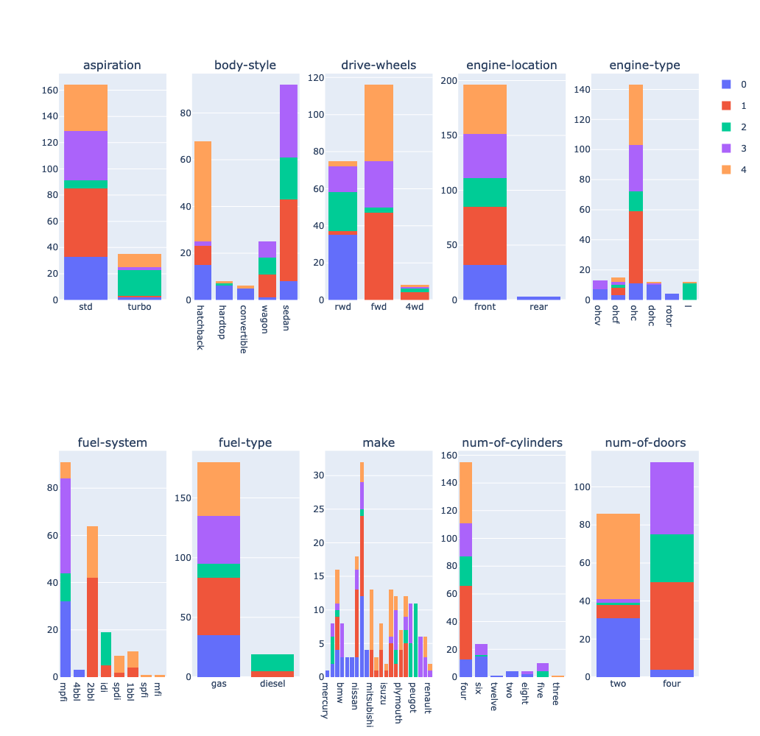
Analysis - Categorical Features
Analyzing categorical features we also see, for example, that many cars with turbo aspiration also have rear wheel drive.
Those correspond to brands such as peugeot and volvo.

Slide 12
Analysis - Predictive Models
We build predictive models based on Lasso (a variant of Linear Regression) and Random Forests.
While Lasso displays less accurate estimates for price, Random Forests can easily overfit the data, so we tune some hyperparameters like as the depth of the corresponding Decision Trees.

